Slide 1
Advanced Statistics Lecture 7
The General Linear Model (GLM)

Slide 2
Goals for today’s lecture
Learn about using discrete variables in regression models
Start using dummy coding
Discuss model examples:
Two groups, no covariate
Two groups, one covariate, same slopes across groups
Two groups, one covariate, different slopes across groups
Three groups, no covariate
Three groups, one covariate, same slopes across groups
Three groups, one covariate, different slopes across groups
Making model comparisons using the F-test
Connection to ANOVA

Slide 3
Discrete variables
Is it possible to perform a regression analysis with discrete (instead of continuous) variables?
Yes!
In fact, when you ask your statistics software to perform an ANOVA, what it does behind the scenes is run a linear model and then do model comparisons using the F-Test
How can we put discrete (that is, non-numerical) variables into the regression model?
We can just replace the different values with (sensible) numbers.
This is called dummy coding.

Slide 4
Example
CatWeight | CatAge | CatBreed | FoodEaten
0.432 | -29.7 | Shorthair | 81.8
0.461 | -36.7 | Shorthair | 82.9
-0.667 | 6.9 | Shorthair | 81.7
1.011 | -24.7 | Shorthair | 87.5
-0.467 | -33.8 | Shorthair | 64.6
-0.008 | -46.5 | Shorthair | 56.6
Let’s just stay with the cat data for a little bit longer
Let’s say our cats came from two breeds, shorthair and manx.
Does breed have an influence on food eaten?
The corresponding file is on Brightspace (catfood_breed.sav; first 6 rows of the table shown)

Slide 5
We could do a t-test

Slide 6
Or we could assign dummy values and do a regression
Let’s recode our variable and assign “0” to all Shorthairs and “1” to all Manxes
We can do that in jamovi under Variables –> Transform –> using transform –> Create New Transform
Then click the Add recode condition button
The first field should read: if $source == "Shorthair" use 0
The second field should read: else use 1
It’s a bit trickier in SPSS, but we can to it there too: Data –> Recode into Different Variables..., and assign 0 to Shorthair and 1 to Manx
We recode our cat breed variable into a variable called dummy, containing 0s and 1s
Or use Excel: for example, if your Breed column is C and the first row is the column labels, make a new formula in D2 that reads =IF(C2 = "Shorthair", 0, 1) and apply it to all rows below

Slide 7
Dummy analysis
 | Estimate | Std. Error | t value | Pr(>|t|)
(Intercept) | 86.1 | 4.14 | 20.78 | 0
dummy | 32.9 | 5.86 | 5.62 | 0
In jamovi: Regression -> Linear Regression, then add your dummy variable as a covariate.
In SPSS: Analyze -> Regression -> Linear..., then add your dummy variable as a predictor.

Slide 8
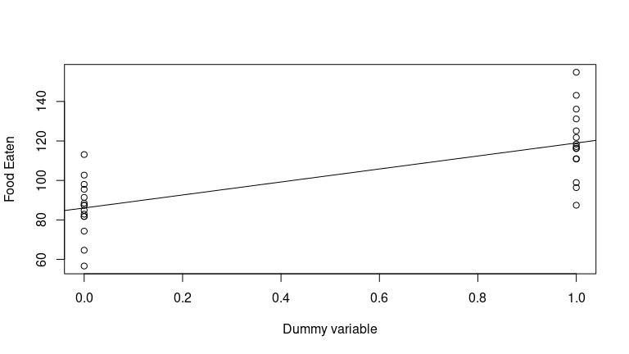
Let’s plot the situation

Slide 9
Interpreting dummy variables
Now, the intercept is the mean for group “shorthair” and the slope gives the difference between group “shorthair” and group “manx”
Remember the regression equation: $$Y_{i}=α+β_{1}X_{i}+ε_{i}$$
If $$x_{i}$$ is 0 (shorthair group), the predicted value y is the intercept ($$α$$)
If $$x_{i}$$ is 1 (manx group), the predicted value is the sum of the intercept ($$α$$) and the slope ($$β_{1}$$).
Fox (2015) uses $$D_{i}$$ instead of $$X_{i}$$ for dummy variables to distinguish them from continuous predictors and $$γ_{i}$$ (gamma) instead of $$β_{i}$$ for the corresponding coefficients, so we’ll go with that, too:
$$Y_{i}=α+γ_{1}D_{i}+ε_{i}$$
But really, this is just a matter of switching the letters, nothing else!

Slide 10
Two regression equations
We can write our regression equations separately for $$D_{i}=0$$ and $$D_{i}=1$$:
When $$D_{i}=0$$ (shorthair cats):
$$Y_{i}=α+γ_{1}D_{i}+ε_{i}=α+γ_{1}⋅0+ε_{i}=α+ε_{i}$$
So here we have an intercept of $$α$$
When $$D_{i}=1$$ (Manx cats):
$$Y_{i}=α+γ_{1}D_{i}+ε_{i}=α+γ_{1}⋅1+ε_{i}=α+γ_{1}+ε_{i}$$
So here we have an intercept of $$α+γ_{1}$$
So, the intercept $$α$$ of the model will be the mean of the observations for shorthair cats ($$D_{1}=0$$)
The coefficient $$γ_{1}$$ will be the difference between the mean of the observations for shorthair cats and the mean of the observations for manx cats ($$D_{1}=1$$).

Slide 11
Different dummy values
Nobody forces us to set the values to 0 and 1
We could use any values we want, e.g. 99 and 23419 (but it would make the resulting equation incredibly hard to interpret)
-1 and 1 might be reasonable.
In jamovi, make a new Transformation and Create a New Transform
Then click the Add recode condition button
The first field now reads: if $source == "Shorthair" use -1
The second field now reads: else use 1
In SPSS, we again use: Data –> Recode into Different Variables..., and assign -1 to Shorthair and 1 to Manx
We recode our cat breed variable into a variable called dummy, containing 0s and 1s
Or use Excel: for example, if your Breed column is C and the first row is the column labels, make a new formula in D2 that reads =IF(C2 = "Shorthair", -1, 1) and apply it to all rows below
Doing this, we make a new dummy variable with -1 representing Shorthair and 1 representing Manx.

Slide 12
Two regression equations, again!
We can write our regression equations separately for $$D_{i}=−1$$ and $$D_{i}=1$$:
When $$D_{i}=−1$$ (shorthair cats):
$$Y_{i}=α+γ_{1}D_{i}+ε_{i}=α+γ_{1}⋅−1+ε_{i}=α−γ_{1}+ε_{i}$$
So here we have an intercept of $$α$$
When $$D_{i}=1$$ (manx cats):
$$Y_{i}=α+γ_{1}D_{i}+ε_{i}=α+γ_{1}⋅1+ε_{i}=α+γ_{1}+ε_{i}$$
- So here we have an intercept of $$α+γ_{1}$$
So, the intercept $$α$$ of the model will be the overall mean of all observations
The coefficient $$γ_{1}$$ will be half of the difference between the mean of the observations for shorthair cats and the mean of the observations for manx cats.

Slide 13
Two regression equations, again! (2)
If we want $$γ_{1}$$ to reflect all difference between the mean of the observations for shorthair cats and the mean of the observations for manx cats, we just have to use -.5 and .5 instead of -1 and 1 as the dummy variables.
This is perfectly fine to do, you just have to remember which one you used when interpreting your estimate of $$γ_{1}$$.

Slide 14
Re-run the analysis
 | Estimate | Std. Error | t value | Pr(>|t|)
(Intercept) | 102.5 | 2.93 | 35.01 | 0
dummy | 16.5 | 2.93 | 5.62 | 0

Slide 15
Note that the numbers are different: now the intercept represents the grand (overall) mean.
The slope tells you how far the means of shorthair and manx are from the grand mean.
The prediction for shorthair is $$102.525−16.456=86.069$$
The prediction for manx is $$102.525+16.456=118.981$$
The t and p values are exactly the same as in the 0 vs. 1 model. The models are equivalent.

Slide 16
Continuous covariates
For example, someone’s IQ might influence their performance in a memory experiment
By including the covariate in the model, we can explain more variance (and take it out of the error variance)
The regression equation (using Fox’s distinction between $$X_{i}$$ and $$D_{i}$$ and $$β_{i}$$ and $$γ_{i}$$) for a model with one covariate and one dummy variable (and no interaction) looks like this:
$$Y_{i}=α+β_{1}X_{i}+γ_{1}D_{i}+ε_{i}$$

Slide 17
Discrete and continuous factors in one model
Now that we have breed coded as a dummy variable, there is no reason why we can’t add other continuous predictor variables and make it a multiple regression.
Let’s see if there is an effect of cat breed if we enter cat age and cat weight into the analysis as covariates (we don’t care about their interaction, which we have shown to not be significant in the first place).

Slide 18
Interpreting the coefficients
 | Estimate | Std. Error | t value | Pr(>|t|)
(Intercept) | 102.525 | 1.932 | 53.06 | 0
CatWeight | 17.794 | 3.537 | 5.03 | 0
CatAge | 0.477 | 0.091 | 5.24 | 0
dummy | 13.560 | 2.080 | 6.52 | 0

Slide 19
We can reject the null hypothesis that Cat Breed (represented by our dummy variable) does not have an effect on food eaten.
Note that, since we are coding Cat Breed as -1 and 1 (and the continuous predictors are centred), our intercept is still the grand mean of FoodEaten. Our dummy variable tells us the distance between the mean of the Shorthair group and the grand mean (on the left) and the distance between the Manx group and the grand mean (on the right)

Slide 20
F-Test
We can do an F-test by ticking F-Test under Overall Model Test in Model Fit in jamovi.
In SPSS, we can do an F-test by using the Univariate test from the General Linear Model module (in the Analyze menu)
## Anova Table (Type III tests) ## ## Response: FoodEaten ## Sum Sq Df F value Pr(>F) ## (Intercept) 315343 1 2815.2 < 2e-16 *** ## CatWeight 2835 1 25.3 0.00003097 *** ## CatAge 3074 1 27.4 0.00001794 *** ## dummy 4763 1 42.5 0.00000065 *** ## Residuals 2912 26 ## --- ## Signif. codes: 0 '***' 0.001 '**' 0.01 '*' 0.05 '.' 0.1 ' ' 1

Slide 21
What does a model with a dummy variable and a covariate look like?
 | Estimate | Std. Error | t value | Pr(>|t|)
(Intercept) | 102.5 | 2.72 | 37.71 | 0.000
CatWeight | 10.8 | 4.61 | 2.34 | 0.027
dummy | 17.3 | 2.74 | 6.32 | 0.000
For simplicity, let’s use a model that just has CatWeight and the dummy variable:

Slide 22
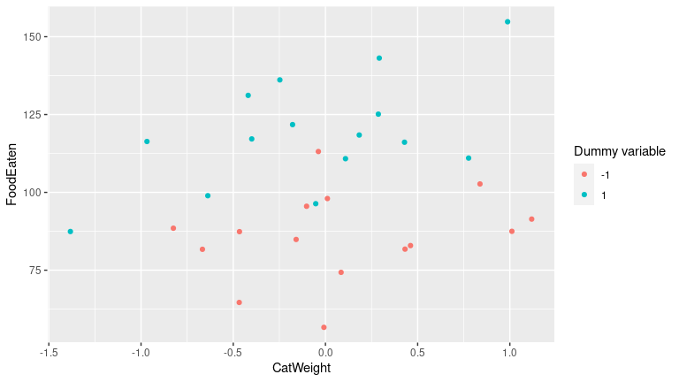
Plot for a model with a dummy variable and a covariate

Slide 23
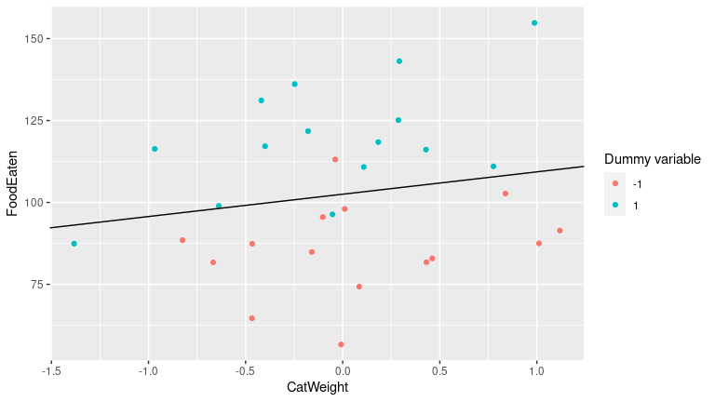
Fitting a line for all points

Slide 24
Fitting different regression lines for each group (1)
Let’s use -1 and 1 as the dummy variable again
$$Y_{i}=α+β_{1}X_{i}+γ_{1}D_{i}+ε_{i}$$
We can write our regression equations separately for $$D_{i}=−1$$ and $$D_{i}=1$$:
When $$D_{i}=−1$$ (shorthair cats):
$$Y_{i}=α+γ_{1}D_{i}+β_{1}X_{i}+ε_{i}=α+γ_{1}⋅−1+β_{1}X_{i}+ε_{i}=α−γ_{1}+β_{1}X_{i}+ε_{i}$$
So here we have an intercept of $$α−γ_{1}$$ and a slope of $$β_{1}$$

Slide 25
Fitting different regression lines for each group (2)
When $$D_{i}=1$$ (manx cats):
$$Y_{i}=α+γ_{1}D_{i}+β_{1}X_{i}+ε_{i}=α+γ_{1}⋅1+β_{1}X_{i}+ε_{i}=α+γ_{1}+β_{1}X_{i}+ε_{i}$$
So here we have an intercept of $$α+γ_{1}$$ and a slope of $$β_{1}$$

Slide 26
Fitting different regression lines for each group (2)
So, the intercept $$α$$ of the model will be the overall mean of all observations
The coefficient $$γ_{1}$$ will be half of the difference between the mean of the observations for shorthair cats and the mean of the observations for manx cats.
The slope of both regression lines will be exactly the same, namely $$β_{1}$$. The lines should be parallel.

Slide 27
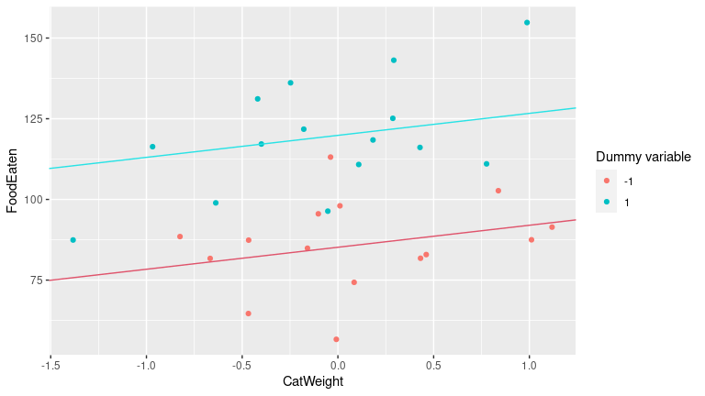
Plotting the effect of the dummy variable

Slide 28
Interactions: Allowing different slopes
What if the effect of CatWeight differs between Shorthair and Manx cats?
If we constrain the slope to be the same for both breeds, we won’t be able to tell if that is the case.
Here is a model that allows for an interaction between one dummy variable and one continuous variable:
$$Y_{i}=α+β_{1}X_{i}+γ_{1}D_{i}+δ_{1}\left(X_{i}D_{i}\right)+ε_{i}$$
Note that the interaction coefficient is called $$δ_{1}$$ (delta) here. This is just a name to remind you of what it’s there for – to the model, it’s just another coefficient.

Slide 29
Two regression equations with different slopes
We’re still using -1 as the dummy variable for Shorthair and 1 as the dummy variable for Manx
If you want to see the same thing with 0 and 1, look on page 142 of Fox (2015).
For Shorthair cats ($$D_{i}$$ = -1):
$$Y_{i}=α+β_{1}X_{i}+γ_{1}×−1+δ_{1}\left(X_{i}×−1\right)+ε_{i}=α−γ_{1}+\left(β_{1}−δ_{1}\right)X_{i}+ε_{i}$$
So the intercept is $$α−γ_{1}$$ and the slope is $$β_{1}−δ_{1}$$
For Manx cats ($$D_{i}$$ = 1):
$$Y_{i}=α+β_{1}X_{i}+γ_{1}×1+δ_{1}\left(X_{i}×1\right)+ε_{i}=α+γ_{1}+\left(β_{1}+δ_{1}\right)X_{i}+ε_{i}$$
So the intercept is $$α+γ_{1}$$ and the slope is $$β_{1}+δ_{1}$$

Slide 30
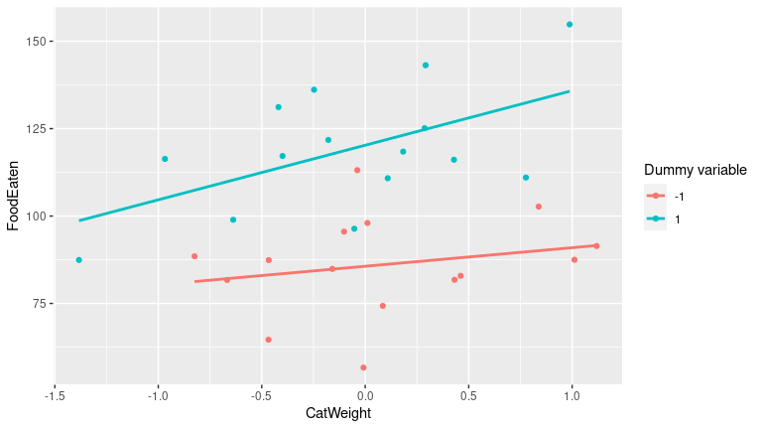
Plotting different slopes

Slide 31
Interpreting the coefficients
$$β_{1}$$ is the average effect of CatWeight across breeds
$$δ_{1}$$ is the slope difference between the two breeds (actually, half the difference, since we used -1 and 1 as dummy variables)
$$α$$ is the grand mean (the average FoodEaten across cats and CatWeights)
$$γ_{1}$$ is the difference between the breeds when $$X_{i}=0$$
It’s not the overall difference between breeds
Often, $$X_{i}=0$$ is not meaningful
Like here: A cat that weighs 0 kg does not exist.
Be very careful interpreting main effects in the presence of interactions!

Slide 32
Marginality
If $$γ_{1}$$ is not interpretable, can we just leave it out of the model?
We could, but that would constrain our model so that Shorthair cats and Manx cats have to have the same intercept.
Why would we do that? Who knows!
Unless you have a specific hypothesis that says that they should have the same intercept, better leave $$γ_{1}$$ in the model.
In general: If you include high-order terms (e.g. interactions), you should also include the corresponding lower order terms (the main effects), unless you have a very good reason not to.

Slide 33
How to fit a model with different slopes
 | Estimate | Std. Error | t value | Pr(>|t|)
(Intercept) | 102.94 | 2.73 | 37.69 | 0.000
CatWeight | 10.46 | 4.60 | 2.28 | 0.031
dummy | 17.31 | 2.73 | 6.34 | 0.000
CatWeight:dummy | 5.15 | 4.60 | 1.12 | 0.273
One slope per level of the dichotomous variable
Add the interaction between dummy and covariate to the model

Slide 34
In this case, the t-test of the coefficient indicates that the interaction is not significant. We can’t reject the null hypothesis that the slopes are the same for each level of the dichotomous variable (despite the slight trend in the data visible in the plot).

Slide 35
Factors with more than two levels
What if we have three (or more) groups that we want to compare in our regression model?
Let’s start with three to keep things simple

Slide 36
Example
Breed | Number of object names known
Beagle | 10
Border Collie | 60
Terrier | 15
Enough about cats, let’s talk about dogs!
In this ficticious example, let’s assume we are testing 45 dogs to see how many object names they know (e.g. when you tell them to bring you a “ball”, “stick”, etc., do they bring you the correct object or a random one?)
Our sample contains 15 beagles, 15 border collies, and 15 terriers.
Let’s assume that the true means $$μ_{i}$$ for each breed are:

Slide 37
Example (2)
Comparison | Difference
Border Collie – Beagle | 50
Border Collie – Terrier | 35
Terrier – Beagle | 5
In a regression model, we would want get three lines, one per group
Of course, there is no covariate in this model, so the lines should be horizontal
The lines should reflect the differences between the means:

Slide 38
Dummy contrasts for three groups
Breed | X1 | X2
Beagle | 0 | 0
Border Collie | 1 | 0
Terrier | 0 | 1
How do we make contrasts in this situation?
Remember, the dummy contrasts for two groups had one level coded as 0 (the baseline) and one coded as 1
The coefficient for the dummy contrasts then told us how the level coded as 1 differed from the baseline
We can apply the same scheme here. Let’s make Beagles the baseline, because they are fantastic dogs:

Slide 39
Note that we need two contrasts here to describe three regression lines
The baseline is described by the intercept

Slide 40
The data
We’re going to simulate getting a sample from the populations I just described.
Note that sample means are not neccessarily the same as the population means
Which is of course the reason why we do inferential statistics in the first place!
The data are in the file dogs.sav on Brightspace
Let’s calculate the means:

Slide 41
Means table
 | Mean number of objects known
Beagle | 8.93
Border Collie | 59.80
Terrier | 12.33

Slide 42
Adding contrasts
 | $$x_{1}$$ | $$x_{2}$$
Beagle | 0 | 0
Border Collie | 1 | 0
Terrier | 0 | 1
We can use Transform -> Recode into Different Variables... in SPSS to make the contrasts.
$$x_{1}$$ will be 1 for all “Border Collie” cases, and 0 otherwise
$$x_{2}$$ will be 1 for all “Terrier” cases, and 0 otherwise
This will make “Beagle” the baseline

Slide 43
How contrasts work
 | $$D_{1}$$ | $$D_{2}$$
Beagle | 0 | 0
Border Collie | 1 | 0
Terrier | 0 | 1
Remember the linear regression equation:
$$Y_{i}=α+γ_{1}D_{1}+γ_{2}D_{2}+ε_{i}$$
i.e. the predicted value for $$Y_{i}$$ is $$\hat{Y_{i}}=α+γ_{1}D_{1}+γ_{2}D_{2}$$
Now let’s substitute in the values from the table if breed is “Beagle”:

Slide 44
$$\hat{Y_{i}}=α+γ_{1}×0+γ_{2}×0=α$$
The predicted value for the Beagle group is $$α$$, the intercept
That means that in this analysis, the intercept will reflect the mean for the Beagle group

Slide 45
How contrasts work (2)
 | $$D_{1}$$ | $$D_{2}$$
Beagle | 0 | 0
Border Collie | 1 | 0
Terrier | 0 | 1
The predicted value for $$Y_{i}$$ is still $$\hat{Y_{i}}=α+γ_{1}D_{1}+γ_{2}D_{2}$$
Now let’s substitute in the values from the table if breed is “Border Collie”:

Slide 46
$$\hat{Y_{i}}=α+γ_{1}×1+γ_{2}×0=α+γ_{1}$$
The predicted value for the Border Collie group is $$α+γ_{1}$$, i.e. the sum of the intercept and the first slope $$γ_{1}$$
That means that in this analysis, the slope $$γ_{1}$$ will reflect the difference between the mean for the Border Collie group and the mean for the Beagle group ($$60−10=50$$)

Slide 47
How contrasts work (3)
 | $$D_{1}$$ | $$D_{2}$$
Beagle | 0 | 0
Border Collie | 1 | 0
Terrier | 0 | 1
The predicted value for $$Y_{i}$$ is still $$\hat{Y_{i}}=α+γ_{1}D_{1}+γ_{2}D_{2}$$
Now let’s substitute in the values from the table if breed is “Terrier”:

Slide 48
$$\hat{y_{i}}=α+γ_{1}×0+γ_{2}×1=α+γ_{2}$$
The predicted value for the Terrier group is $$α+γ_{2}$$, i.e. the sum of the intercept and the second slope $$γ_{2}$$
That means that in this analysis, the slope $$γ_{2}$$ will reflect the difference between the mean for the Terrier group and the mean for the Beagle group ($$15−10=5$$)

Slide 49
Why only two contrasts and not three?
Breed | Beagle | Border Collie | Terrier
Beagle | 1 | 0 | 0
Border Collie | 0 | 1 | 0
Terrier | 0 | 0 | 1
Why can’t we use three contrasts like this?

Slide 50
We would have too many parameters: There are only three group means, but we would represent them using four parameters, namely $$α$$, $$γ_{1}$$, $$γ_{2}$$, and $$γ_{3}$$.
Also, the dummy variable for Terrier is completely dependent on the other two: $$D_{3}=1−D_{1}−D_{2}$$.
This means that $$D_{3}$$ is perfectly correlated with $$D_{1}$$ and $$D_{2}$$ ($$R_{2}=1$$), making it impossible to fit a least-squares model.

Slide 51
Let’s run the regression analysis
In jamovi: Regression -> Linear Regression, then add D_1 and D_2 as covariates.
OR Regression -> Linear Regression, then add breed as a factor
OR install gamlj (in Modules), then Linear Models -> General Linear Model, then add breed as a factor
Advantage: you have many more built-in contrast schemes to choose from (under Factors Coding, the one we want is dummy)
In SPSS: Analyze -> Regression -> Linear..., then add D_1 and D_2 as predictors.

Slide 52
Results
 | Estimate | Std. Error | t value | Pr(>|t|)
(Intercept) | 8.93 | 1.52 | 5.86 | 0.000
breedBorder Collie | 50.87 | 2.16 | 23.59 | 0.000
breedTerrier | 3.40 | 2.16 | 1.58 | 0.122

Slide 53
Note that D_1 is called breedBorder Collie here and D_2 is called breedTerrier as a reminder of what they stand for
Looks just about right in terms of the intercept and the differences (remember, the means differ from the true population means because this is a (simulated) sample and contains random error)

Slide 54
Adding a covariate
 | Estimate | Std. Error | t value | Pr(>|t|)
(Intercept) | 9.161 | 1.432 | 6.40 | 0.000
breedBorder Collie | 51.063 | 2.022 | 25.25 | 0.000
breedTerrier | 3.303 | 2.021 | 1.63 | 0.110
dog_iq | 0.143 | 0.055 | 2.61 | 0.013
Let’s assume that we have done a “Doggy IQ” test on each dog (no idea how that would work, but bear with me), and that there are no differences in “Doggy IQ” between breeds
Let’s fit a model that tests the effect of “Doggy IQ” and breed, assuming that the effect of “Doggy IQ” is the same across breeds (i.e. no interactions).
For our convenience, dog_iq is centred already.

Slide 55
Regression equations
This time, our general equation is (note the difference between this and using -1 and 1 for contrasts):
$$\hat{Y_{i}}=α+β_{1}×X_{1}+γ_{1}×D_{1}+γ_{2}×D_{2}$$
Plugging in the dummy values for the Beagle group:
$$\hat{Y_{i}}=α+β_{1}×X_{1}+γ_{1}×0+γ_{2}×0=α+β_{1}×X_{1}$$
Intercept is $$α$$ and slope is $$β_{1}$$
Plugging in the dummy values for the Border Collie group:
$$\hat{Y_{i}}=α+β_{1}×X_{1}+γ_{1}×1+γ_{2}×0=α+γ_{1}+β_{1}×X_{1}$$
Intercept is $$α+γ_{1}$$ and slope is $$β_{1}$$
Plugging in the dummy values for the Terrier group:
$$\hat{Y_{i}}=α+β_{1}×X_{1}+γ_{1}×0+γ_{2}×1=α+γ_{2}+β_{1}×X_{1}$$
Intercept is $$α+γ_{2}$$ and slope is $$β_{1}$$

Slide 56
Interpreting the coefficients
$$α$$ is the mean for the Beagle group
$$γ_{1}$$ is the difference between the mean for the Beagle group and the mean for the Border Collie group
$$γ_{2}$$ is the difference between the mean for the Beagle group and the mean for the Terrier group
$$β_{1}$$ is the slope, which is the same for all groups

Slide 57
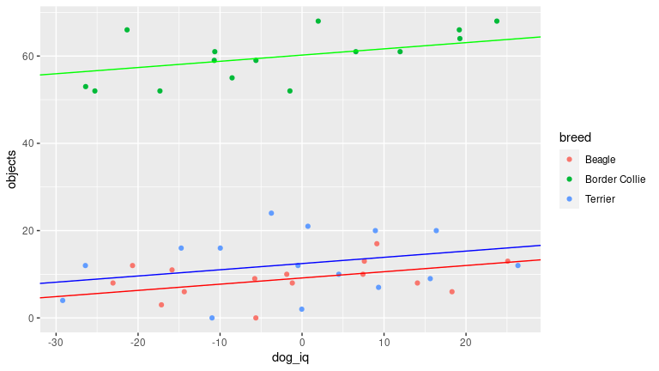
Plotting this situation

Slide 58
Allowing different slopes (interactions)
Note that we’re using 0 vs. 1 dummy contrasts now! This affects the interpretation of the coefficients!
Now, our general equation is:
$$\hat{Y_{i}}=α+β_{1}X_{1}+γ_{1}D_{1}+γ_{2}D_{2}+δ_{1}\left(X_{1}D_{1}\right)+δ_{2}\left(X_{1}D_{2}\right)$$
Plugging in the dummy values for the Beagle group:
$$\hat{Y_{i}}=α+β_{1}X_{1}=α+β_{1}X_{1}$$
Intercept is $$α$$ and slope is $$β_{1}$$, since everything else is 0

Slide 59
Allowing different slopes (interactions, 2)
Plugging in the dummy values for the Border Collie group:
$$\hat{Y_{i}}=α+β_{1}X_{1}+γ_{1}+δ_{1}X_{1}=α+γ_{1}+\left(β_{1}+δ_{1}\right)X_{1}$$
Intercept is $$α+γ_{1}$$ and slope is $$β_{1}+δ_{1}$$

Slide 60
Allowing different slopes (interactions, 3)
Plugging in the dummy values for the Terrier group:
$$\hat{Y_{i}}=α+β_{1}X_{1}+γ_{2}+δ_{2}X_{1}=α+γ_{2}+\left(β_{1}+δ_{2}\right)X_{1}$$
Intercept is $$α+γ_{2}$$ and slope is $$β_{1}+δ_{2}$$

Slide 61
Interpreting the coefficients
$$α$$ is the mean for the Beagle group at $$X_{i}=0$$ (remember, interactions! Here, $$X_{i}=0$$ is actually meaningful since it is the mean of all “Doggie IQ” scores)
$$γ_{1}$$ is the difference between the mean for the Beagle group and the mean for the Border Collie group at $$X_{i}=0$$
$$γ_{2}$$ is the difference between the mean for the Beagle group and the mean for the Terrier group at $$X_{i}=0$$
$$β_{1}$$ is the slope for the Beagle group
$$δ_{1}$$ is the difference between the slope for the Beagle group and the slope for the Border Collie group
$$δ_{2}$$ is the difference between the slope for the Beagle group and the slope for the Terrier group

Slide 62
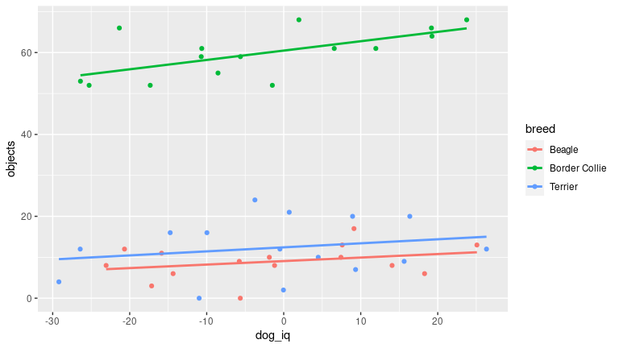
Plotting this situation

Slide 63
Let’s run the regression analysis
 | Estimate | Std. Error | t value | Pr(>|t|)
(Intercept) | 9.070 | 1.448 | 6.265 | 0.000
breedBorder Collie | 51.410 | 2.059 | 24.968 | 0.000
breedTerrier | 3.353 | 2.043 | 1.641 | 0.109
dog_iq | 0.086 | 0.100 | 0.857 | 0.397
breedBorder Collie:dog_iq | 0.143 | 0.135 | 1.058 | 0.297
breedTerrier:dog_iq | 0.013 | 0.139 | 0.091 | 0.928
In SPSS: Use Compute Variable... to add interaction terms between dog_iq and the dummy variables
Then Analyze -> Regression -> Linear..., then add dog_iq, D_1, D_2 and the two interaction terms as predictors.
In jamovi: Regression -> Linear Regression, then add breed as a factor and dog_iq as a covariate
OR install gamlj (in Modules), then Linear Models -> General Linear Model, then add breed as a factor and dog_iq as a covariate (no need to calculate the interaction terms separately in jamovi)

Slide 64
Summary: Contrasts
The link between (multiple) regression, t-tests, and ANOVA
Using dummy coding to turn a discrete variable into a number of “continuous” contrasts
Many possible contrasts – you can make your own!
Not very many sensible contrasts.
Basic principles: A factor with $$k$$ levels gets split into $$k−1$$ contrasts.
i.e. one contrast per degree of freedom

Slide 65
Hypothesis tests for dummy-coded variables
We’ve already seen t-tests in the coefficient tables
These work just like we’ve seen in the last lecture
Can we test more general hypotheses? For example, can we just test whether adding breed as a predictor improves the model (without considering the different dummy contrasts?)
Yes, we can! Remember the F-test from the last lecture?
We can use this F-test not only to test the entire model, but to compare several models.
To start with, let’s consider the model with different intercepts, but the same slopes:
$$\hat{Y_{i}}=α+β_{1}X_{1}+γ_{1}D_{1}+γ_{2}D_{2}$$

Slide 66
The incremental F-test
We can use an F-test to test a null hypothesis about a subset of the regression slopes.
In this case, we’d like to test the null hypothesis of whether $$γ_{1}$$ and $$γ_{2}$$ are 0
$$H_{0}:γ_{1}=γ_{2}=0$$
Assume we don’t care about $$β_{1}$$, so let’s not test that.
In effect, we want to compare these two models: Model 1: $$\hat{Y_{i}}=α+β_{1}X_{1}+γ_{1}D_{1}+γ_{2}D_{2}$$ vs. Model 0: $$\hat{Y_{i}}=α+β_{1}X_{1}+0×D_{1}+0×D_{2}$$ or simplified: Model 0: $$\hat{Y_{i}}=α+β_{1}X_{1}$$

Slide 67
The incremental F-test (2)
We want to compare which of the models explains more (systematic) variance
Remember from last time that a model with extra predictors will always explain a little bit of extra variance just by chance?
We want to test if the increase in explained variance is significant.
In order to do this, we need the residual sums of squares of the null model ($${RSS}_{0}$$) and the residual sums of squares of the full model ($${RSS}_{1}$$)
If the full model explains a lot of extra variance (i.e. if the null hypothesis is wrong), $${RSS}_{1}$$ should be a lot smaller than $${RSS}_{0}$$, so that $${RSS}_{0}−{RSS}_{1}$$ should be large.

Slide 68
The incremental F-test (3)
We can also express this in terms of the regression sums of squares of the models ($${RegSS}_{0}$$ and $${RegSS}_{1}$$)
If the full model explains a lot of extra variance (i.e. if the null hypothesis is wrong), $${RegSS}_{0}$$ should be a lot smaller than $${RegSS}_{1}$$, so that $${RegSS}_{1}−{RegSS}_{0}={RSS}_{0}−{RSS}_{1}$$ should be large.
If the null hypothesis is true, the incremental variance should simply be another unbiased estimator of the residual error $$σ_{ε}^{2}$$, so that dividing it by the residual error variance of the full model should result in a value close to 1.
How do we calculate the incremental variance? We divide $${RegSS}_{1}−{RegSS}_{0}$$ by the number of extra predictors in the full model (i.e the extra degrees of freedom, in this case 2)

Slide 69
The incremental F-test (4)
The residual error variance of the full model is still $$\frac{{RSS}_{1}}{n−k−1}$$, so overall we get:
$$F_{0}=\frac{\left({RegSS}_{1}−{RegSS}_{0}\right)/q}{{RSS}_{1}/\left(n−k−1\right)}$$
$$q$$ is the number of extra predictors, i.e. 2 in our example
We can also express this using the squared multiple correlations of the full and null models ($$R_{1}^{2}$$ and $$R_{0}^{2}$$):
$$F_{0}=\frac{n−k−1}{q}×\frac{R_{1}^{2}−R_{0}^{2}}{1−R_{1}^{2}}$$

Slide 70
Example
In our dog example, the model with the two dummy contrasts for breed has $$R_{1}^{2}=0.951$$, while the model with just dog_iq has $$R_{0}^{2}=0.002$$
So, the $$F_{0}$$-value is
$$F_{0}=\frac{n−k−1}{q}×\frac{R_{1}^{2}−R_{0}^{2}}{1−R_{1}^{2}}=\frac{41}{2}×\frac{0.951−0.002}{1−0.951}=398.758$$
This is a bit of an extreme case!
The F-value has $${df}_{1}=41$$ and $${df}_{2}=2$$
We could look this up now, but the resulting p-value is almost certainly tiny!
Now let’s do this in SPSS!

Slide 71
Final notes
You may have noticed that this is (essentially) an ANCOVA!
If we didn’t have dog_iq in the model, it would be an ANOVA.
So there you have it – the two methods are essentially the same!
Next week, we’ll talk more about ANOVAs and about using contrasts for planned comparisons.

